Slide 1

Image caption generator
Mohd Jibran
Mohd Asif
Final PPT

Slide 2
Python based Project – Learn to Build Image Caption Generator with CNN & LSTM
When we saw any image and our brain can easily tell what the image is about, but can a computer tell what the image is representing?
Computer vision researchers worked on this a lot and they considered it impossible until now! With the advancement in Deep learning techniques, availability of huge datasets and computer power, we can build models that can generate captions for an image.
This is what we are going to implement in this Python based project where we will use deep learning techniques of Convolutional Neural Networks and a type of Recurrent Neural Network (LSTM) together.

Slide 3
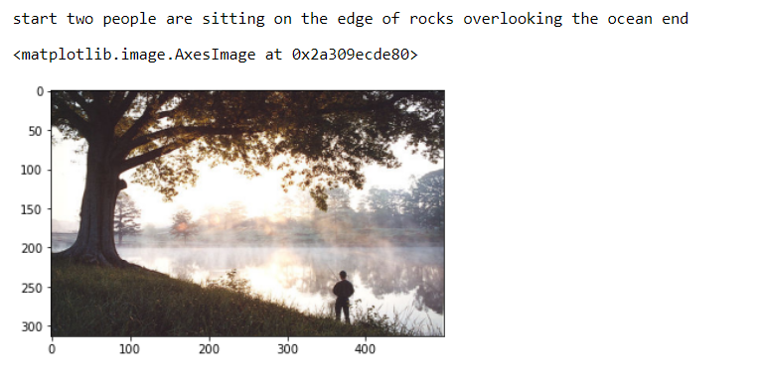
What is Image Caption Generator?
Image caption generator is a task that involves computer vision and natural language processing concepts to recognize the context of an image and describe them in a natural language like English.

Slide 4
Hear we will using following necessary libraries:
Numpy
Pandas
tensorflow
keras
tqdm
jupyterlab

Slide 5
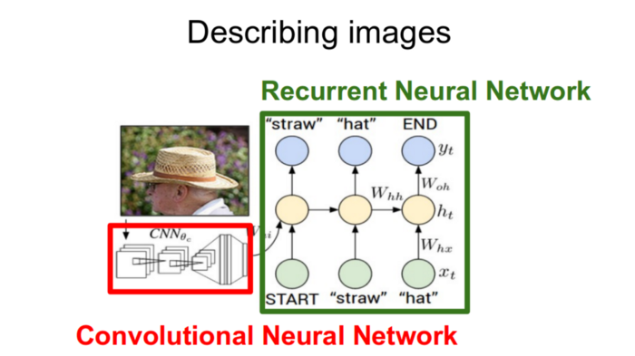
Image Captioning
The task of image captioning can be divided into two modules logic
Image based model — Extracts the features of our image.
Language based model — which translates the features and objects extracted by our image based model to a natural sentence.
For our image based model– we use CNN, and for language based model — we use LSTM. The following image summarizes the approach of Image Captioning Generator.
For our image based Model -Usually rely on a Convolutional Neural Network model.
For language based models — rely on LSTM. The image below summarizes the approach.

Slide 6
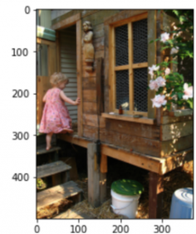
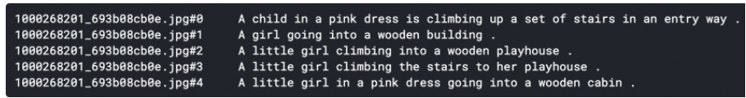
Dataset
There are many open source dataset available hear we are using Flick8k dataset
Flick8k_Dataset/ :- contains the 8000 images
The image dataset is divided into 6000 images for training, 1000 images for validation and 1000 images for testing.
Flick8k_Text/
Flickr8k.token.txt:- contains the image id along with the 5 captions
Flickr8k.trainImages.txt:- contains the training image id’s
Flickr8k.testImages.txt:- contains the test image id’s
Image and its CAPTION

Slide 7
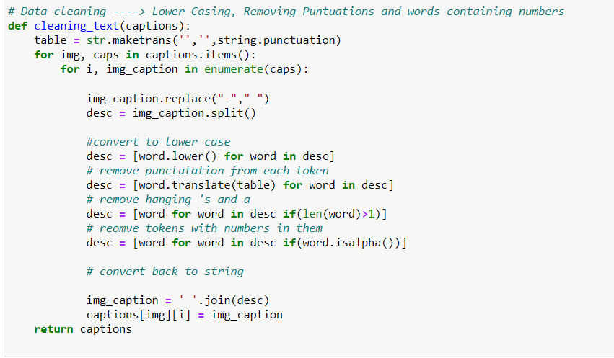
Cleaning text
We are going to clean the text in following order to achieve the size of vocabulary:
Convert to lower case
remove punctutation from each token
remove hanging 's and a
remove tokens with numbers in them

Slide 8
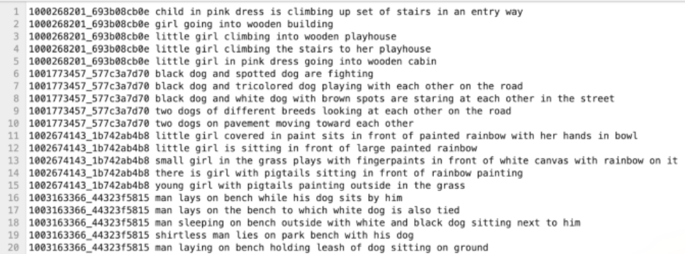
A snippet of the output file — description.txt file should look like this:

Slide 9
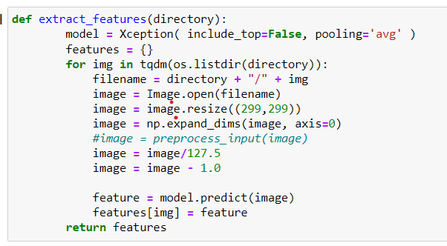
PREPROCESSING THE IMAGE:
For feature extraction, the image features are in 299*299 size. The features of the image are extracted just before the last layer of classification as this is the model used to predict a classification for a photo. We are not interested in classifying images; hence we excluded the last layer.

Slide 10
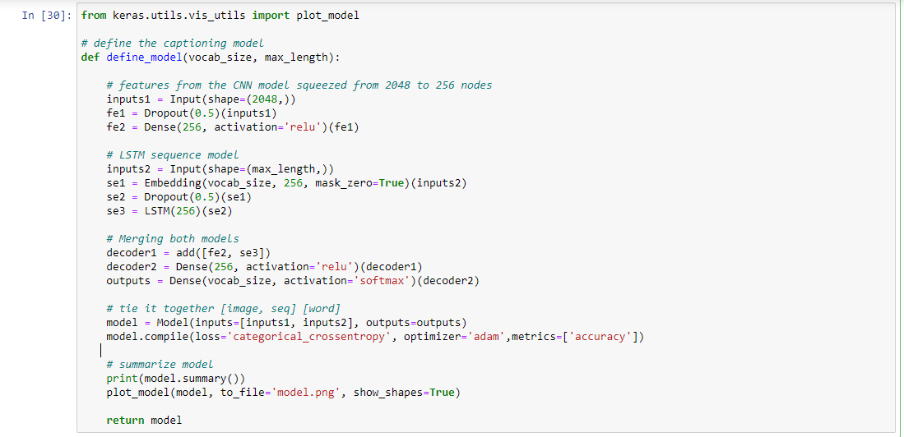
CNN-LSTM MODEL:

Slide 11
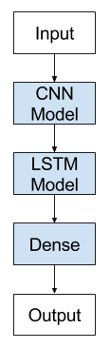
CNN-LSTM ARCHITECTURE
The CNN-LSTM architecture involves using CNN layers for feature extraction on input data combined with LSTMs to support sequence prediction.
The general architecture of the CNN-LSTM Model is as follows:

Slide 12
CONCLUSION
In this advanced Python project, we have implemented a CNN-RNN model by building an image caption generator. Some key points to note are that our model depends on the data, so, it cannot predict the words that are out of its vocabulary. We used a small dataset consisting of 8000 images. For production-level models, we need to train on datasets larger than 100,000 images which can produce better accuracy models.

